Slide 1
How The Web Works

Slide 2
Internet vs. Web
The Internet is a network of connected computers. The purpose of connecting computers together, of course, is to share information.
The Web (originally called the World Wide Web, thus the “www” in site addresses) is just one of the ways information can be shared over the Internet.
It is unique in that it allows documents to be linked to one another using hypertext links—thus forming a huge “web” of connected information.
The Web uses a protocol called HTTP (HyperText Transfer Protocol).

Slide 3
HTTP
The HyperText Transfer Protocol (HTTP) defines how web pages are transferred across the Internet.
HTTP is a request-and-response protocol that connects clients and servers.
Web browser (client) : software that fetches or display document from web server.
Contoh : Opera, IE, Mozilla, Google Chrome.
Web server : software that listent for request.
Contoh : Apache, IIS.

Slide 4
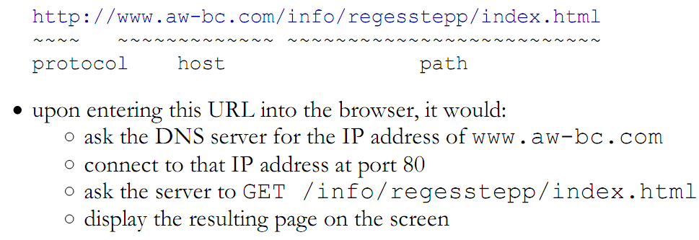
Uniform Resource Locator (URL)
Every page and resource on the Web has its own special address called a URL, which stands for Uniform Resource Locator.

Slide 5
Uniform Resource Locator (URL) (cont.)
When a server receives a request for a directory name rather than a specific file, it looks in that directory for a default document, typically named index.html, defauult.html, index.php or etc depend on configuration of the web server.
http://www.oreilly.com
http://www.jendesign.com/resume/
http://www.oreilly.com/index.html http://www.jendesign.com/resume/index.html

Slide 6
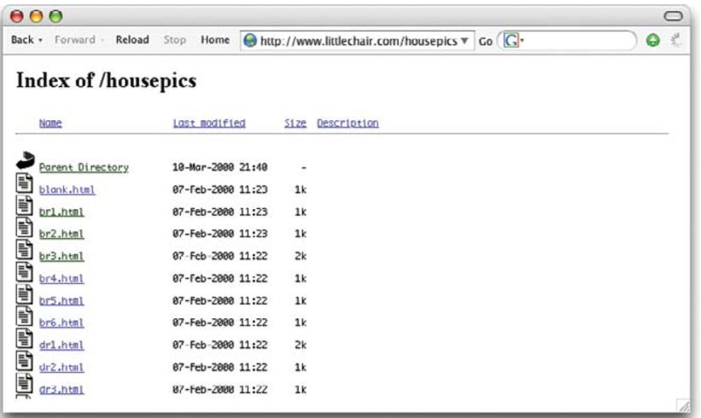
Uniform Resource Locator (URL) (cont.)
The index file is also useful for security. Some servers (depending on their configuration) display the contents of the directory if the default file is not found.

Slide 7
Domain Name System (DNS)
DNS was developed to allow us to refer to server address by its domain name.
For example the server of oreilly has IP address 208.201.239.100, can be access using the domain name “oreilly.com”, as well.
The numeric IP address is useful for computer software, while the domain name is more accessible to humans.
Matching the text domain names to their respective numeric IP addresses is the job of a separate DNS server.
It is possible to configure your web server so that more than one domain name is mapped to a single IP address, allowing several sites to share a single server.

Slide 8
HTTP and Internet
An HTTP client initiates a request by establishing a TCP connection to a particular port on a remote host (port 80 is the default).
An HTTP server listening on that port waits for the client to send a request message.
Upon receiving the request, the server sends back a status line, like “HTTP/1.1 200 OK,” and its own response.
Depending on the status, this response could be the requested file, an error message, or some other information.

Slide 9
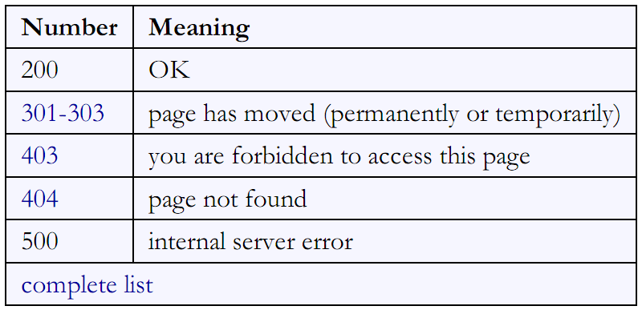
Some HTTP Error Codes

Slide 10
Web-related technologies
Hypertext Markup Language (HTML)
Cascading Style Sheets (CSS)
JavaScript and DOM scripting
Server-side programming and database management

Slide 11
Hypertext Markup Language (HTML)
HTML is the language used to create web, the current version is HTML 5.
HTML is not a programming language;
It is a markup language, which means it is a system for identifying and describing the various components of a document such as headings, paragraphs, and lists.
The markup indicates the document’s underlying structure.
You don’t need programming to write HTML.
The best way to learn HTML is to write out some pages by hand.

Slide 12
Cascading Style Sheets (CSS)
CSS describe how that content should look.
Fonts, colors, background images, line spacing, page layout, and so on… all controlled with CSS.
With the newest version (CSS3), you can even add special effects and basic animation to your page.
Style sheets are also a great tool for automating production because you can change the way an element looks across all the pages in your site by editing a single style sheet document.

Slide 13
JavaScript and DOM scripting
JavaScript is a scripting language that is used to add interactivity and behaviors to web pages, including:
Checking form entries for valid entries
Swapping out styles for an element or an entire site
Building interface widgets, such as expanding menus
DOM (Document Object Model) refers to the standardized list of web page elements that can be accessed and manipulated using JavaScript (or another scripting language).

Slide 14
Server-side programming
Some simple websites are collections of static HTML documents and image files.
But most commercial sites have more advanced functionality such as forms handling, dynamically generated pages, shopping carts, content management systems, databases, and so on.
These functions are handled by web applications running on the server.
There are a number of programming languages: PHP, Python, Ruby, JavaScript (Node.js, Rhino, SpiderMonkey), Java, ASP.Net.

Slide 15
The World Wide Web Consortium (W3C)
W3C is the organization that oversees the development of web technologies.
The group was founded in 1994 by Tim Berners-Lee, the inventor of the Web, at the Massachusetts Institute of Technology (MIT).
Now, the W3C is laying a foundation for the future of the Web by developing dozens of technologies and protocols that must work together in a solid infrastructure.
Site: www.w3schools.org

Slide 16
Static vs Dynamic Web Pages
Static web pages
are relatively simple to create
don’t offer much interaction
Dynamic web pages
dynamic means that the user interacts with the web site beyond just reading pages

Slide 17
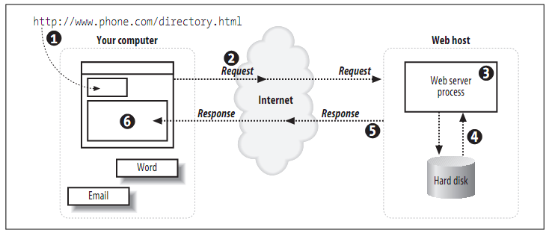
Request Static Web Pages

Slide 18
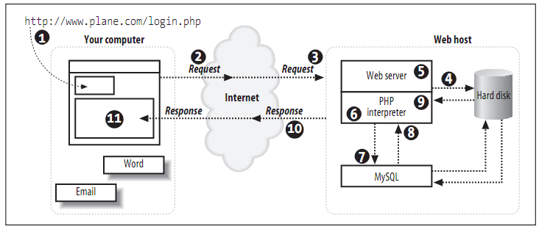
Request Dynamic Web Pages

Slide 19
Creating Dynamic Web Pages
There are three main components of creating dynamic web pages:
a web server
Examples: Apache, Microsoft’s Internet Information Services (IIS)
a server-side programming language,
Examples: PHP Microsoft’s Active Server Pages (ASP) and Sun’s Java Server Pages (JSP)
a database
Examples: MySQL, PostgreeSQL, Oracle

Slide 20
Web Design

Slide 21
Web Design
The term “web design” has come to encompass a number of disciplines, including:
Visual (graphic) design
User interface and experience design
Web document and style sheet production
Scripting and programming
Content strategy
Multimedia
Large-scale websites are almost always created by a team of people, numbering from a handful to hundreds.
In this scenario, each member of the team focuses on one facet of the site-building process.

Slide 22
Web Design (cont.)
Roles and responsibilities typically covered under the umbrella term “web design”:
Design
Development
Content strategy
Multimedia

Slide 23
1. Design
On the Web, the first matter of business is designing how the site works.
identify the site’s goals,
how it will be used,
how visitors move through it.
These tasks fall under the disciplines of:
Interaction Design (IxD)
User Interface (UI) design
User Experience (UX) design
There is a lot of overlap between these responsibilities

Slide 24
1. Design (cont.)
Interaction Design (IxD)
to make the site as easy, efficient, and delightful to use as possible.
User Interface (UI) design
tends to be more narrowly focused on the functional organization of the page as well as the specific tools (buttons, links, menus, and so on) that users use to navigate content or accomplish tasks.
User Experience (UX) design
takes a more holistic view, that include includes “all aspects of the user’s interaction with the product: how it is perceived, learned, and used.”
Notes:
the visual design, the user interface, the quality and message of the content,
and even overall site performance.

Slide 25
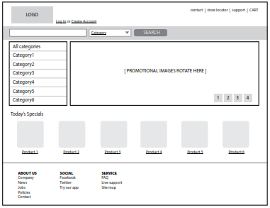
1. Design (cont.)
Some of the documents an IxD, UI, or UX designer might produce include:
User research and testing reports
By interviews and observations, in order to gain a better understanding of how the site can solve problems or how it will be used.
Wireframe diagrams
Notes:
A wireframe diagram shows the structure of a web page using only outlines for each content type and widget

Slide 26
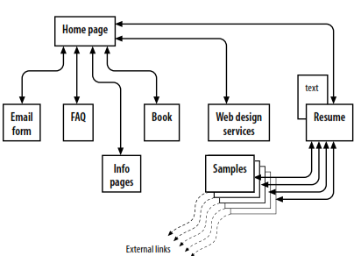
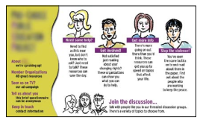
1. Design (cont.)
Site diagram
Visual (graphic) design
“look and feel” of the site—logos, graphics, type, colors, layout, etc

Slide 27
2. Development
Authoring/ markup
the process of preparing content for delivery on the Web that describe its content and function.
Styling
(Cascading Style Sheets).
Scripting and programming
Scripting: javascript → adds behaviors and functionality to elements in the page
Programming: PHP, Ruby, Java, etc → run on the server and process data and information before it is sent to the user’s browser.

Slide 28
2. Development (cont.)
Frontend design
It refers to any aspect of the design process that appears in or relates directly to the browser.
Graphic design, Interface design, HTML document and style sheet development, JavaScript.
Backend design
It refers to the programs and scripts that works on the server behind the scenes to make web pages dynamic and interactive.
Forms processing, Database programming
Other server-side web applications using PHP, JSP, Ruby, ASP.NET, Java, and other programming languages

Slide 29
3. Content Strategy and creation
A Content Strategist
makes sure that every bit of text on a site, from long explanatory text down to the labels on buttons, supports the brand identity and marketing goals of the company.
An Information Architect (also called an Information Designer)
Organizes the content logically and for ease of findability.
may be responsible for search functionality, site diagrams, and how the content and data is organized on the server.

Slide 30
4. Multimedia
It is related to add multimedia elements to a site, including sound, video, animation, and even interactive games.

Slide 31
Software for Web Design and Development
Web page authoring
These tools provide a visual “WYSIWYG” (What You See Is What You Get, pronounced “whizzy-wig”) interface and shortcuts that save you from typing repetitive HTML and CSS.
Example: Adobe Dreamweaver, Microsoft Expression Web (Windows only), Nvu (Linux, Windows, and Mac OS X)
HTML editor
They do not allow you edit the page visually, so you need to check your work in a browser.
Example: Notepad++, Sublime, TextPad, HTML-Kit Tools

Slide 32
Software for Web Design and Development
Image editing and drawing software
You’ll probably want to add images to your pages, so you will need an image-editing program.
Example: Adobe Photoshop, Adobe Illustrator, Adobe Fireworks, Corel Paint, etc.
Internet tools
A variety of browsers, for example: Google Chrome, Mozilla, IE, Safari, etc.
A file-transfer program (FTP), enables you to upload and download files between your computer and the computer that will serve your pages to the web. For example: CuteFTP, Filezilla, Cyberduck, etc.

Slide 33
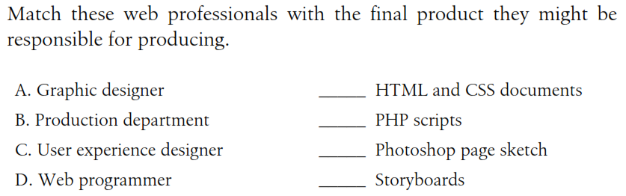
Test yourself

Slide 34
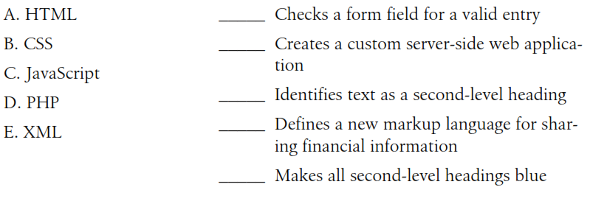
Test yourself

